Slide 1

Customer Shopping Behavior Analysis
Uncovering spending patterns, customer segments, product preferences, and subscription behavior from 3,900 transactions to guide strategic business decisions.

Slide 2
Dataset at a Glance
3,900
18
37
Transactions
Columns
Missing Values
Total purchases analyzed
Features per record
In Review Rating column
Demographics
Purchase Details
Behavior
Age, Gender, Location, Subscription Status
Item, Category, Amount, Season, Size, Color
Discounts, Promo Codes, Frequency, Ratings, Shipping

Slide 3

Data Preparation in Python
01
Load & Explore
Imported dataset with pandas; used df.info() and .describe() for structure and summary stats.
02
Clean & Standardize
Imputed missing Review Ratings using category median; renamed columns to snake_case.
03
Feature Engineering
Created age_group and purchase_frequency_days columns; dropped redundant promo_code_used.
04
Database Integration
Loaded cleaned DataFrame into PostgreSQL for SQL analysis.

Slide 4
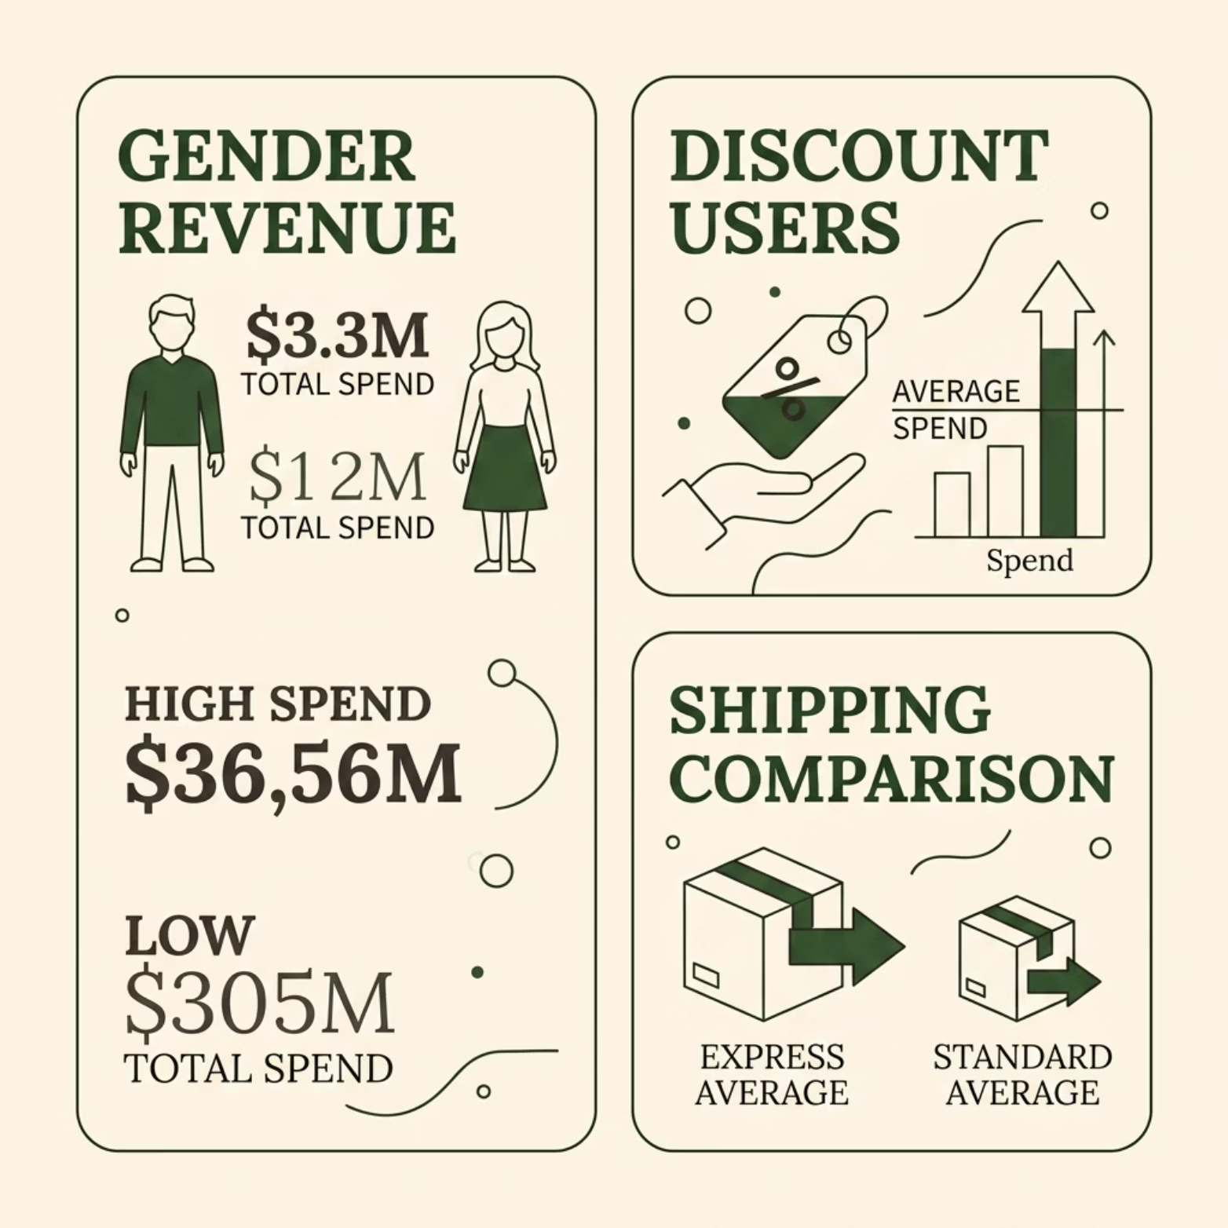

SQL Analysis: Revenue & Spending
Revenue by Gender
Compared total revenue generated by male vs. female customers to identify high-value segments.
High-Spending Discount Users
Identified customers who used discounts yet still spent above the average purchase amount.
Shipping Type Comparison
Compared average purchase amounts between Standard and Express shipping users.

Slide 5
SQL Analysis: Products & Ratings
1
2
3
Top 5 Products by Rating
Discount-Dependent Products
Top 3 per Category
Identified products with the highest average review ratings across all categories.
Listed the most purchased products within each product category.
Found 5 products with the highest percentage of discounted purchases.

Slide 6
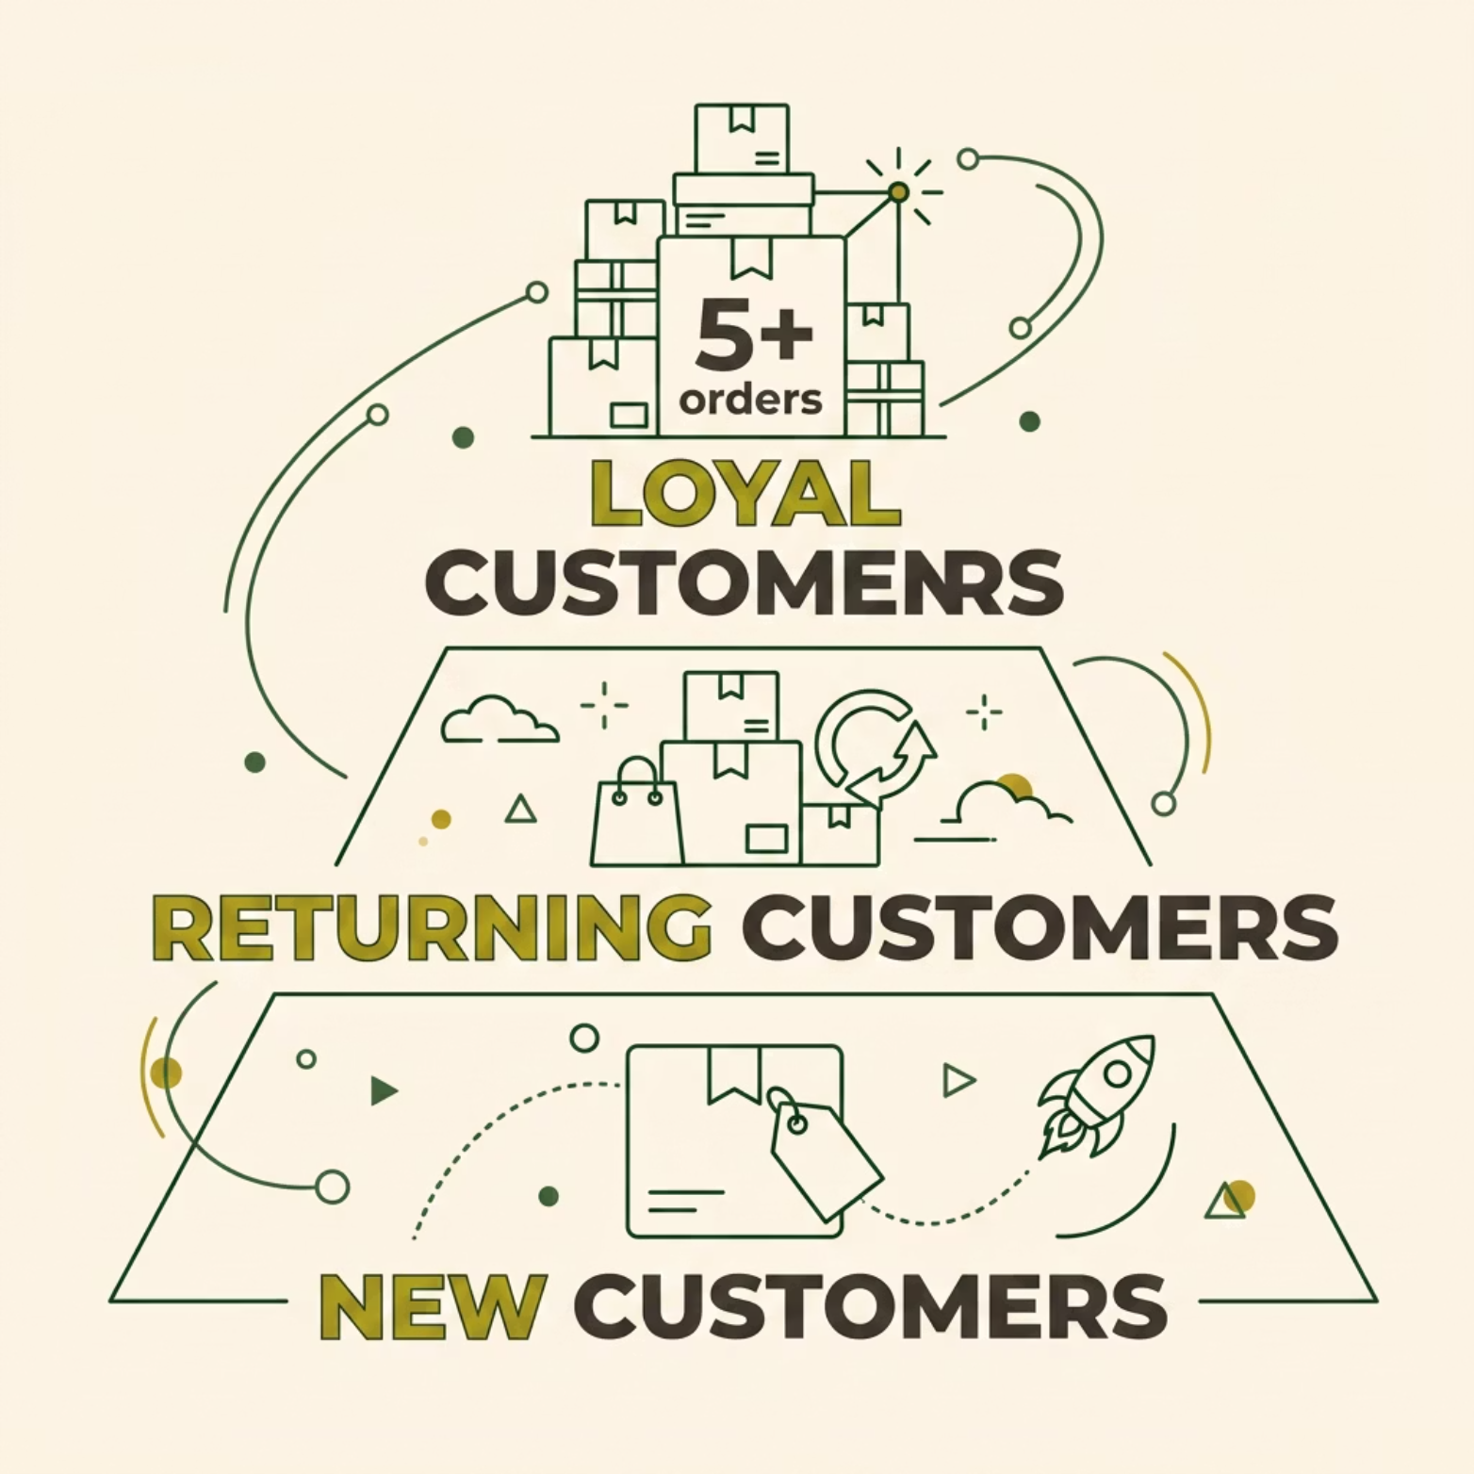
SQL Analysis: Customer Segmentation
Segment Classification
Customers classified as New, Returning, or Loyal based on purchase history.
Repeat Buyers & Subscriptions
Customers with more than 5 purchases were found to be more likely to subscribe.
Revenue by Age Group
Calculated total revenue contribution of each age group to identify high-value demographics.

Slide 7


Subscribers vs. Non-Subscribers
Key Finding
Subscribers show higher average spend and greater total revenue contribution compared to non-subscribers.
Customers with 5+ purchases are significantly more likely to hold an active subscription.
This signals a strong link between purchase frequency and subscription uptake — a key lever for revenue growth.

Slide 8

Power BI Dashboard
An interactive dashboard was built in Power BI to present all insights visually — enabling stakeholders to explore spending patterns, segment behavior, and product performance at a glance.

Slide 9

Business Recommendations
Boost Subscriptions
Loyalty Programs
Promote exclusive benefits to convert frequent buyers into subscribers.
Reward repeat buyers to move them into the "Loyal" segment.
Review Discount Policy
Targeted Marketing
Balance sales boosts with margin control on discount-dependent products.
Focus on high-revenue age groups and express-shipping users.

Slide 10
Key Takeaways
Data-Driven Foundation
Subscription = Higher Value
3,900 transactions cleaned and enriched in Python, then analyzed in PostgreSQL for robust insights.
Subscribers and repeat buyers (5+ purchases) consistently outspend non-subscribers.
Product & Discount Strategy
Actionable Segments
Top-rated products and discount-heavy items need distinct positioning and pricing strategies.
New, Returning, and Loyal segments enable precise, high-impact marketing campaigns.

